Slide 1
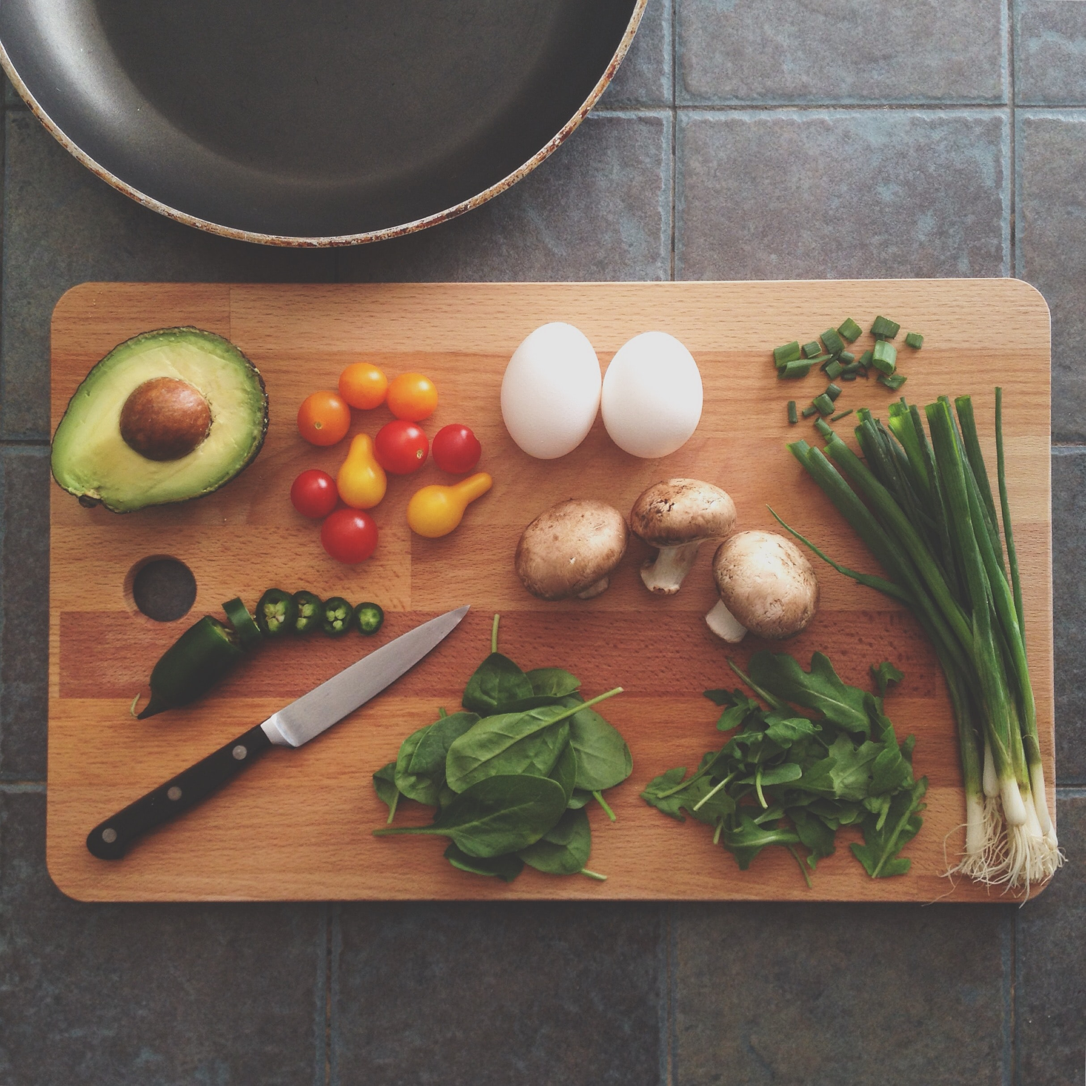
FridgeMate
By Adrienne Smith & Shelby El-rassi

Slide 2
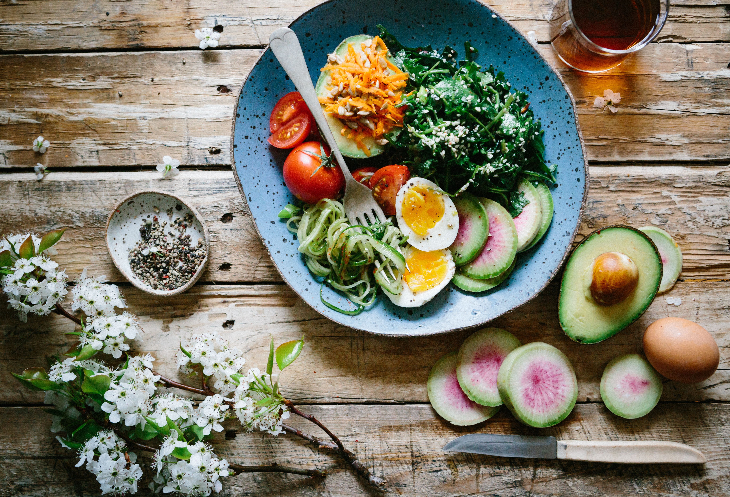
Introduction
FridgeMate
The idea for FridgeMate stemmed from the situation of the first Australian lockdown of Covid, in which stores sold out of a lot of popular and favourite grocery items of customers. An application such as this means users can input the ingredients they have currently at home and recipes including these ingredients will be displayed. The overall goal of this application is a search application based on user ingredient lists, with the ability to save those recipes, rate and review recipes.

Slide 3
Our Team
Adrienne Smith
Front-End Development
@Adrienne_es
Shelby El-rassi
Back-End Development
@theartydev

Slide 4
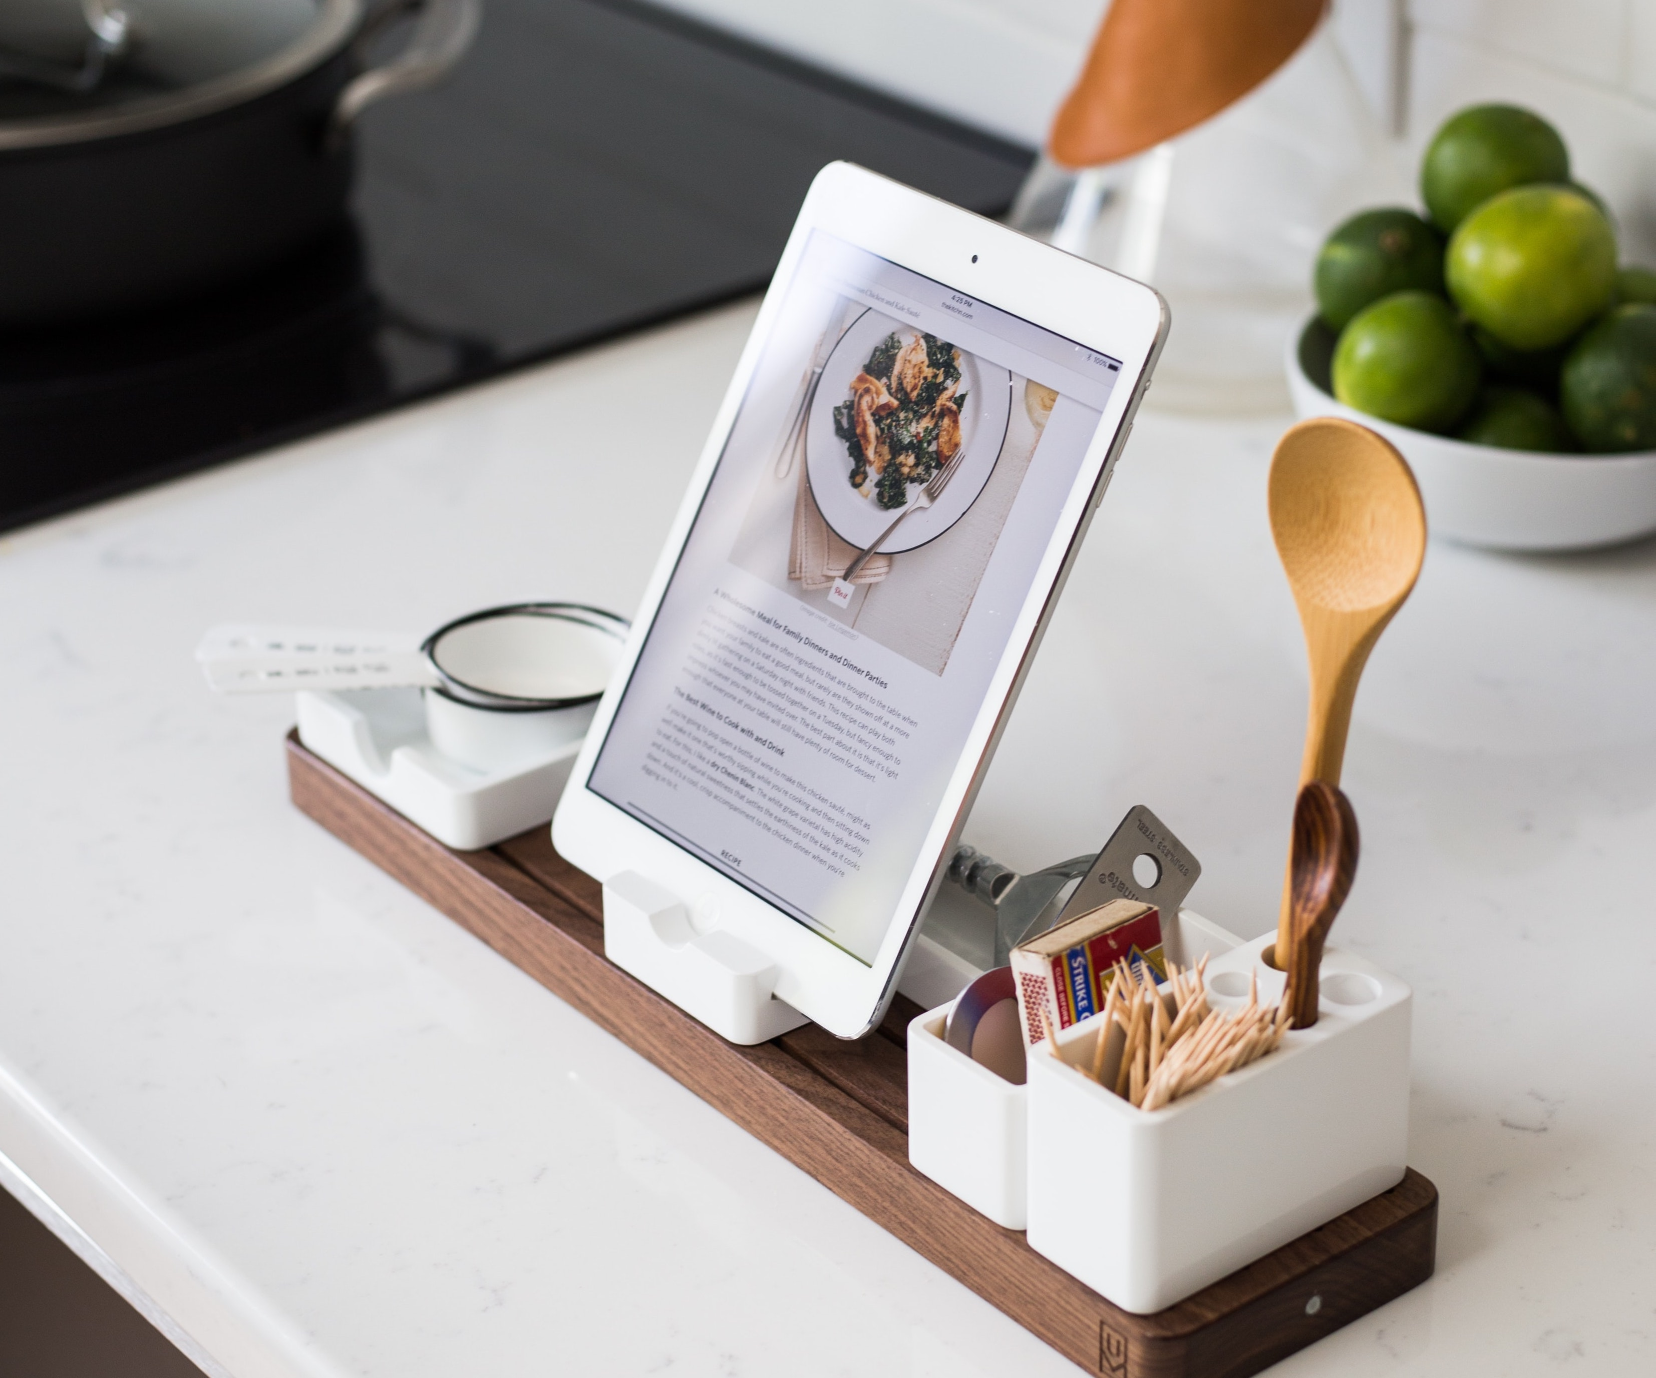
Our Planning
Agile format- setting weekly/fortnightly .
Trello formatted with core coloured cards RUBRIC, TESTING, SERVER, CLIENT. Housing our implementation plans.
Additional cards for DONE, CURRENTLY, REVISE, and SPRINTS.
Final card for DEVELOPMENT and PRODUCTION for last minute bugs and notes.
We formatted the SERVER and CLIENT cards with features.
Decided for the MVP product that Shelby would stick to the back-end and Adrienne on the front-end to ensure timeliness.
During the timeline, Shelby did start completing the client side styling code along with assisting with the integration of react and back-end, this allowed for Adrienne fully tackle the the client-side testing with cypress and main react code for the features.

Slide 5
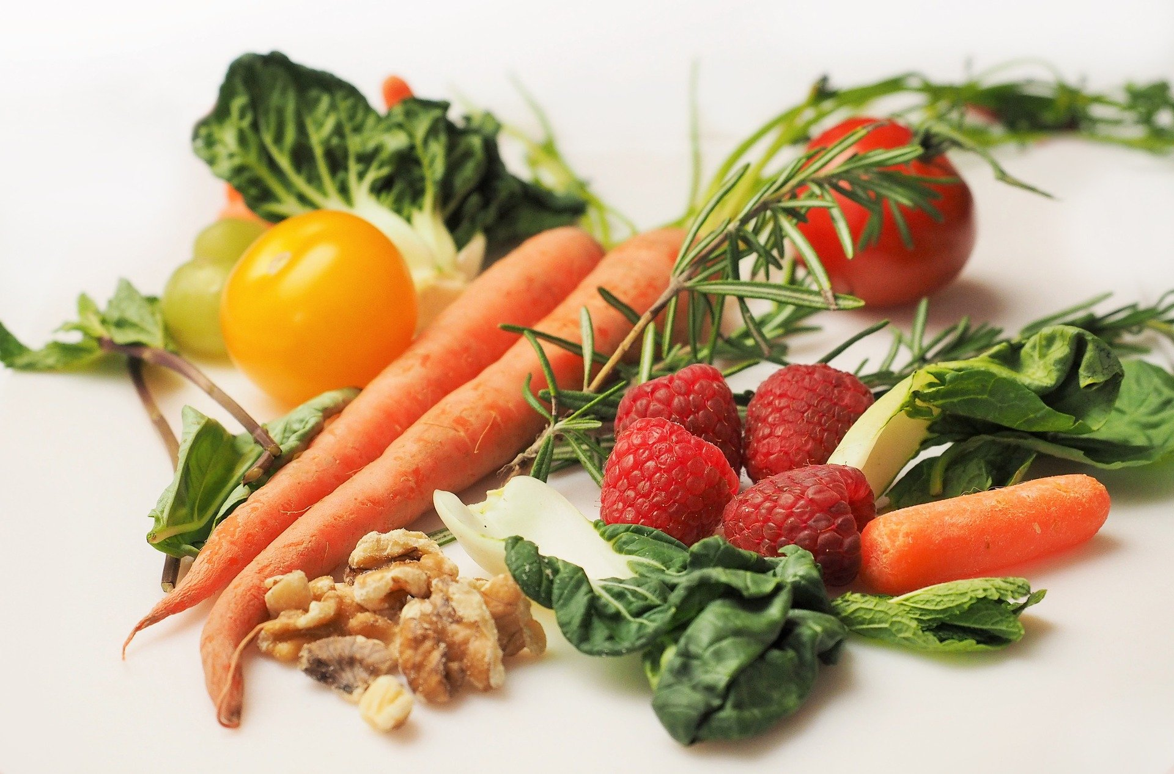
Table of Contents
01
02
03
04
Problem & Solution
Features & Functionality
Demo
Challenges and Changes
What the app solves.
Current and future along with the core function.
See what the app can do!
What we faced along the way!

Slide 6
Problem
Stores sell out of favorite ingredients
Stick to grocery budget(not buy extra items)
Recipe inspiration
Dietary Requirements
New to cooking
Minimize food waste

Slide 7
Solution
Input ingredients from fridge and pantry
Select dietary requirements in preferences.
Search for recipes with these parameters.
Save recipes.
View how many ingredients the user has vs does not have.

Slide 8
Target
Age and gender
Main Interests
Health/diet
Cooking
Saving Money
Trying new things
Content Types
70%
90%
30%
18-31
31-55
Blog Posts
Social media
Other

Slide 9



Our Plans
Future
Login/register via google
Recipes of the week.
Rating/reviewing.
Filter on browse recipe page.
Current
Improvement
User Account
Fridge Ingredients
Preferences
Pantry Staples
Browse Recipes
Save Recipes
More preference options.
Fridge ingredients categorized.
Different collections for saved recipes.
Search history capture.

Slide 10
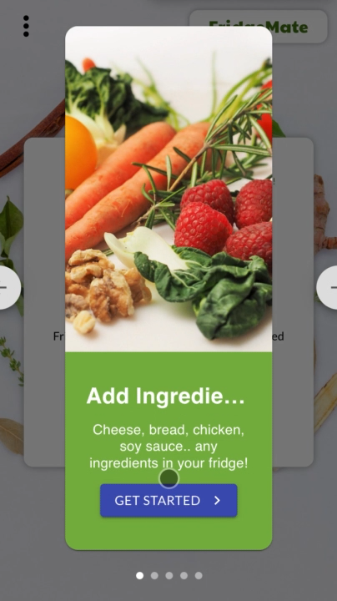
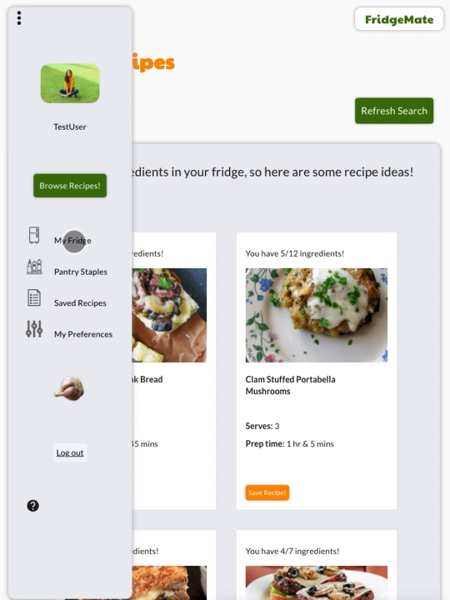
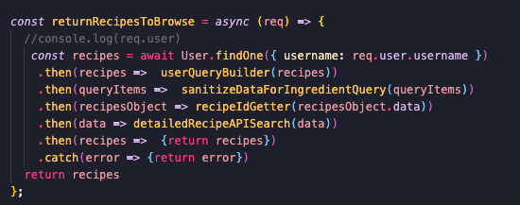
Core Functionality
Browse Recipe Search
Tablet
Asynchronous function calling modularized functions.
Find the User.
Extra user information (ingredients, prefs).
Sanitize ingredients (if null return random recipes), if not call 1st Spoonacular API end point (ingredient search).
Gather the recipe IDs, used and missed ingredients from the data.
Call next Spoonacular API end point, detailed recipe search using gathered ID’s.
Then combine array of objects from first call, and array of objects from next call to a hybrid array of objects to be sent to FE.
Jupiter is a gas giant and the biggest planet in our Solar System

Slide 11
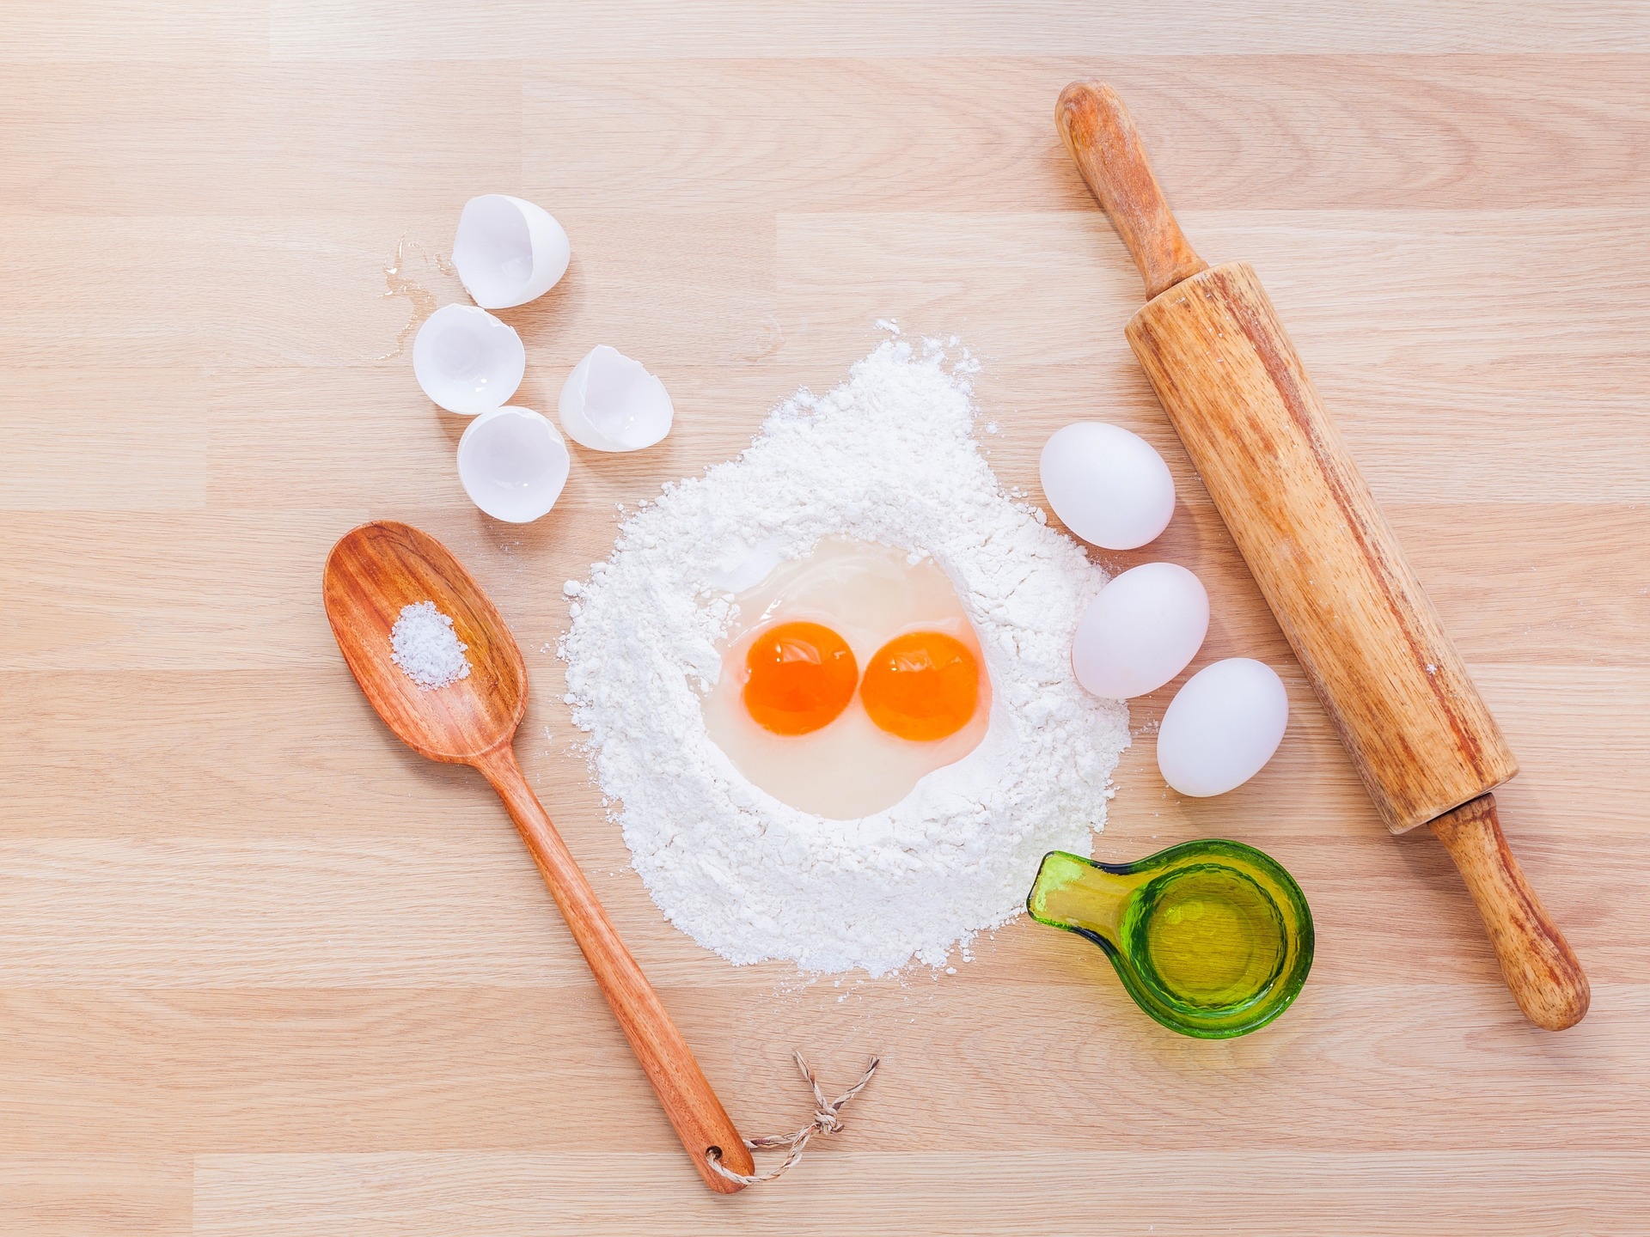
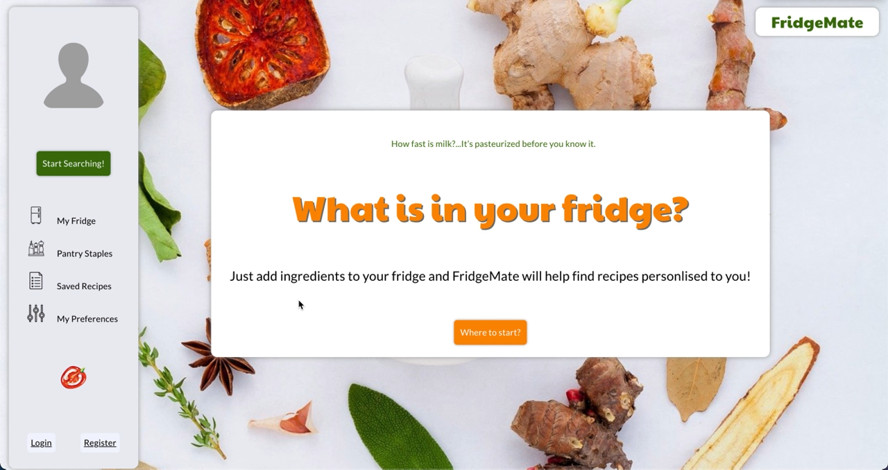
Full Demo
Desktop
Venus has a beautiful name and is the second planet from the Sun. It’s terribly hot

Slide 12
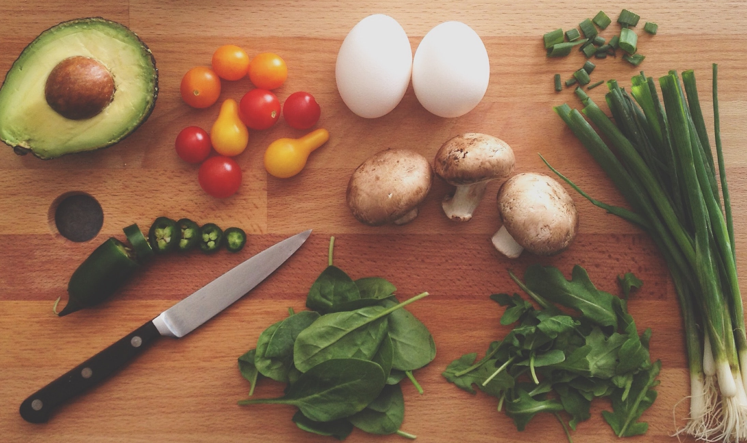
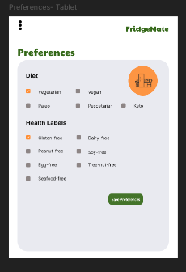
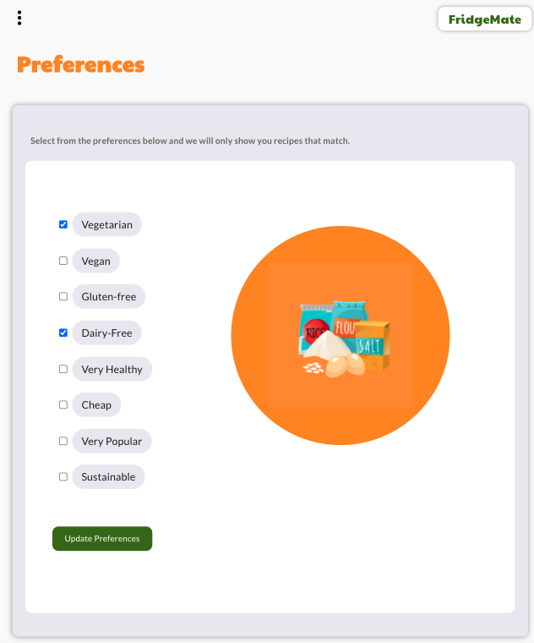
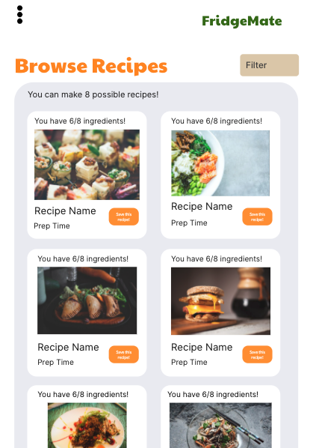
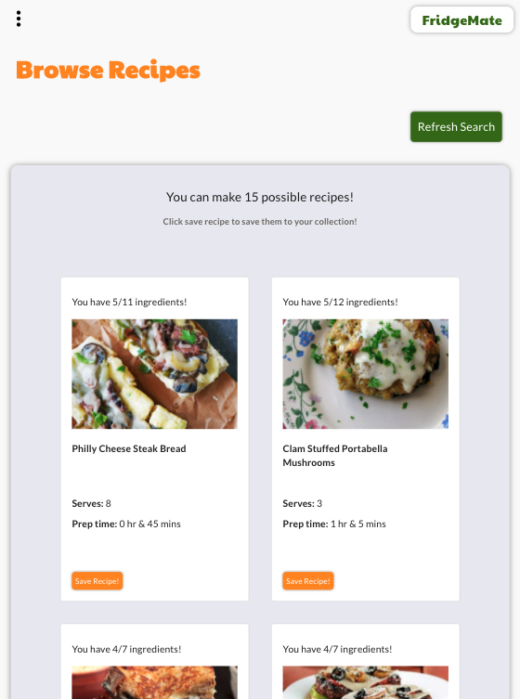
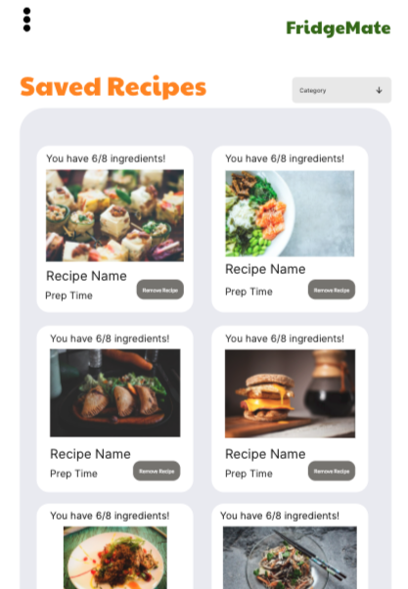
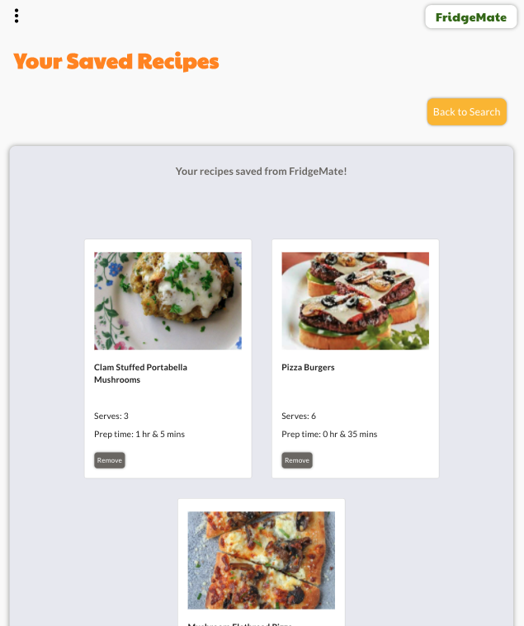
Planned
Changes
Preferences
Preferences- Diet and Health Labels
Saved Recipes- Breakfast, lunch, dinner, snack categories.
Search Recipes - Large filter feature for search recipes.
Browse Recipes
Preferences- limited selection due to API paid tiers.
Saved Recipes- No categories- later feature.
Search Recipes - Added to future features.
Saved Recipes
Notes:
z

Slide 13
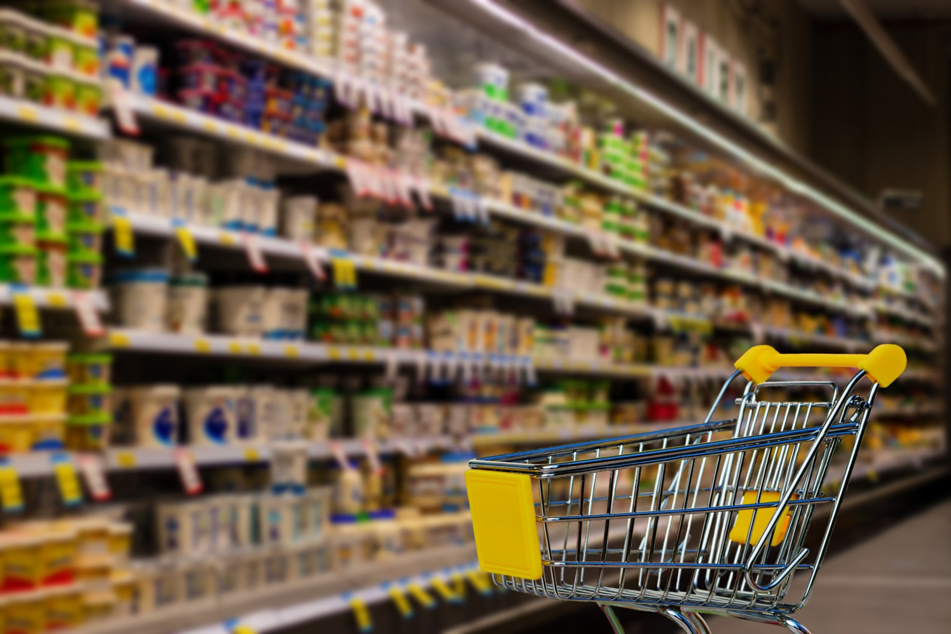
Challenges
Server
Client
JWT as auth in cookie.
Persisting cookies in test files.
Validation (eg. email and username on sign up) Express-validator solved this.
Search options with Spoonacular API, we wanted results from both so we combined.
Adjusted preferences due to payment tiers.
Correct DB find and update so that data was no override. Find by ID and update did this.
Local storage usage. String only, so large data needed to be stringified and parsed.
Calling DB when necessary, using local storage for larger data (recipe results).
Material UI autocomplete- clearing the components after adding.
Filtering ingredients after adding, so as no duplicates were added.
JWT in cookie not being held in browser in deployment.

Slide 14
Reviews
—Bez
—Sarah
—Wayne
“This app has given me so many recipes with eggs! The sky is the limit!”
“I really like the section that tells me which ingredients I have!”
“The recipes are really simple, not too complex!”

Slide 15
Thank You
Does anyone have any questions?

Slide 16
Help & Support Icons
Avatar Icons

Slide 17
Creative Process Icons
Performing Arts Icons

Slide 18
Nature Icons

Slide 19
SEO & Marketing Icons

Slide 20


